Slide 1
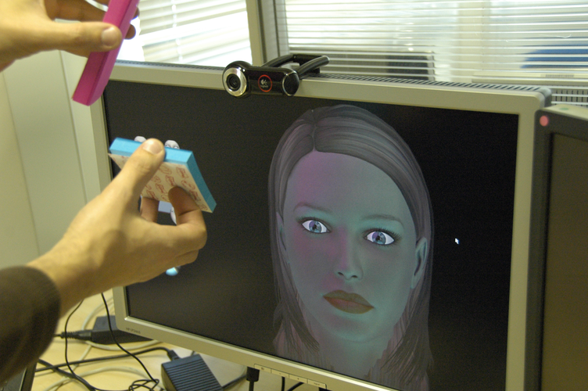

Grabbing Real Light
SCCG 2011
Pascal Gautron, Jean-Eudes Marvie, Cyprien Buron
Technicolor Research & Innovation

Slide 2
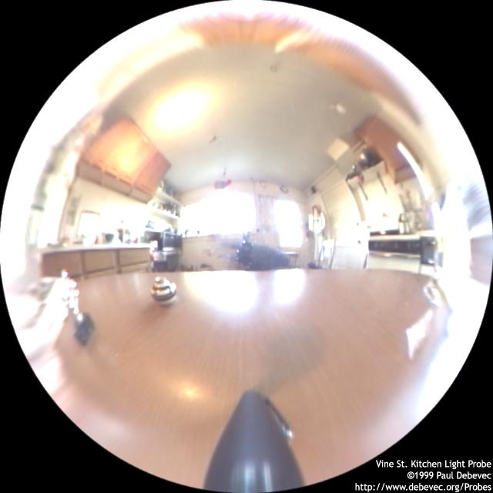
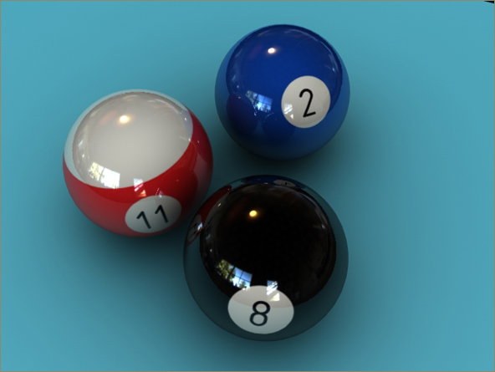
Introduction
Virtual/Real issue
  Virtual scenes rendering
    Reduces the gap virtual/real
  Immersion sensation
    Real lighting into virtual worlds
  Our lighting method
    Webcam
    Environment mapping based

Slide 3
Outline
  Classical environment map
  Our solution
    Angular mapping
    Filtering
    Extrapolation
  Results & video

Slide 4
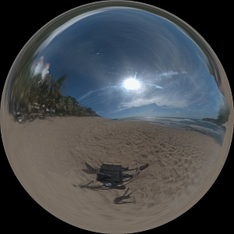
Classical Environment Map
  Goal
    Simulate lighting conditions
    Simplify rendering
  Theory
    Distant light sources
    For a given direction, the incoming lighting is the same regardless of the location in space
    Environment map
      One pixel = one direction
light

Slide 5
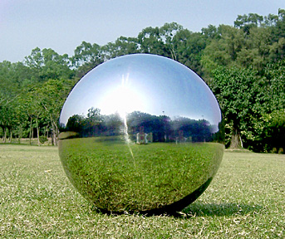
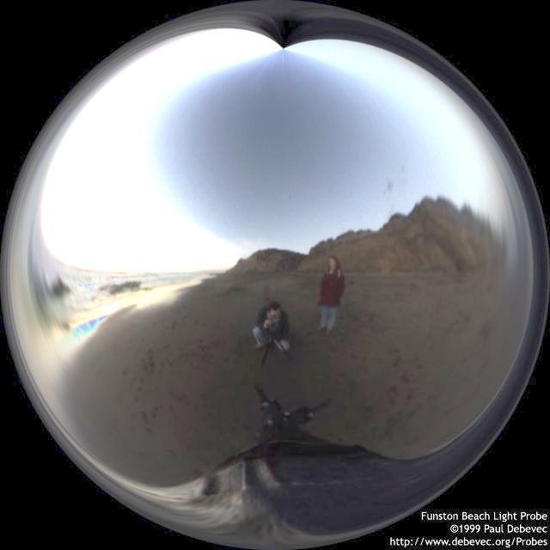
Classical Environment Map
  Acquisition & Rendering
    Pictures of a mirror ball
      High quality digital camera
    Static scene
      Light probes [Debevec 97]
        HDR images
    Dynamic scene [Havran 05][Mannami 07]
      Specific hardware
    Acquisition not in real time
    Require expensive hardware

Slide 6
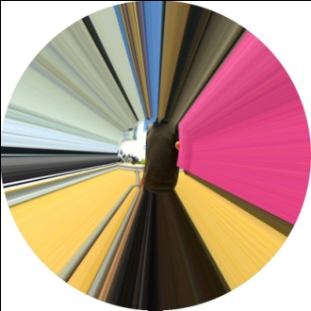

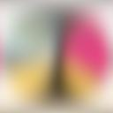
Classical Environment Map
  Filtering
    Simulate surface properties
      Diffuse, glossy, etc
    Integrate the incoming lighting on the hemisphere H around d:
  How to avoid costly sampling at runtime ?
    Pre-convolution
      Sampling all the possible pixels of the mirror ball
      Huge amount of computations

Slide 7
Outline
  Classical environment map
  Our solution
    Angular mapping
    Filtering
    Extrapolation
  Results

Slide 8

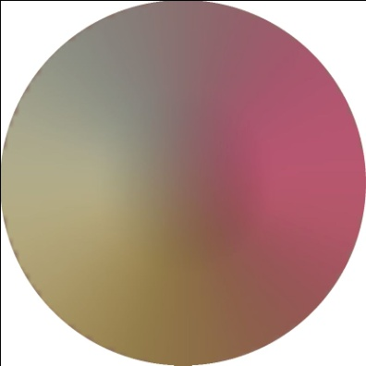
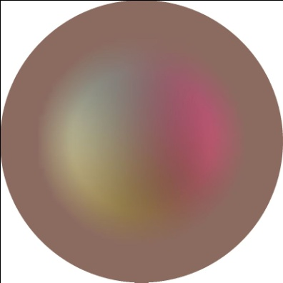
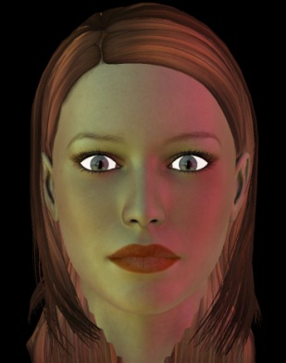
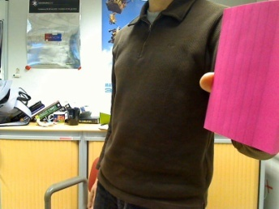
Our Environment Map
  Approximation of classical environment map
    Real time method
    Webcam based
  Pipeline: From the webcam to the rendering
Webcam capture
Angular mapping
Filtering
Extrapolation
Rendering

Slide 9
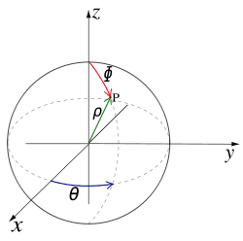
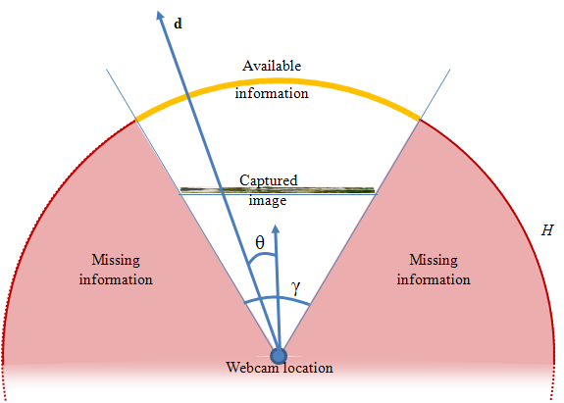
Our Environment Map
Angular mapping
  Filling the angular map
    For each pixel, get the incoming correspondant direction
      Direction dir =
    Then we read the webcam image at pixel (x,y)

Slide 10

Our Environment Map
Angular mapping
  The aperture of the webcam is limited
    How to choose the incoming light of missing parts ?
  Border pixel extrapolation

Slide 11
Our Environment Map
Environment filtering
  Importance sampling
    For each pixel p of the virtual mirror ball
      Direction d
      Set of random directions of the hemisphere
        Cosine distribution around d
      Using Monte Carlo integration :
      With

Slide 12
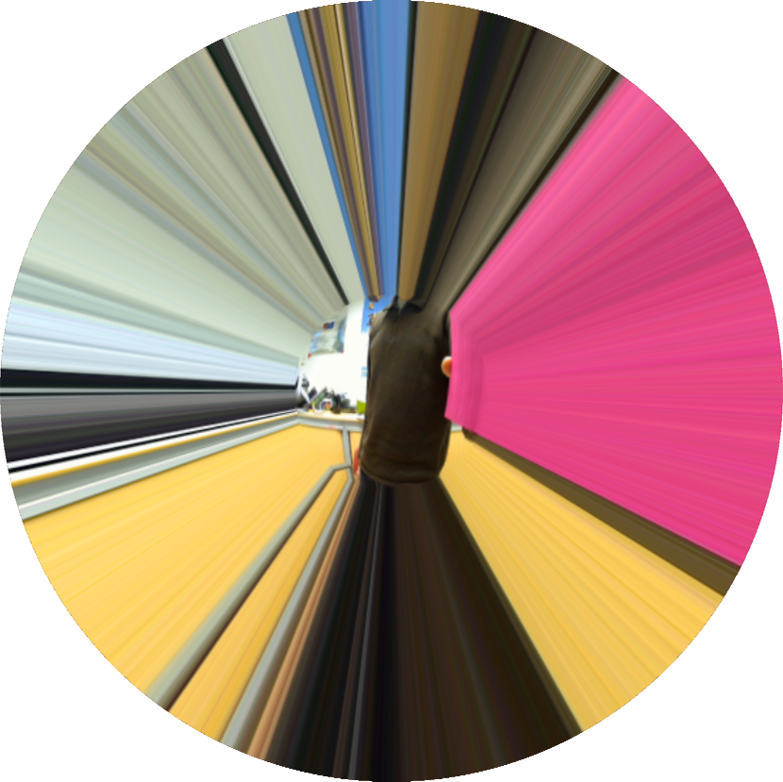
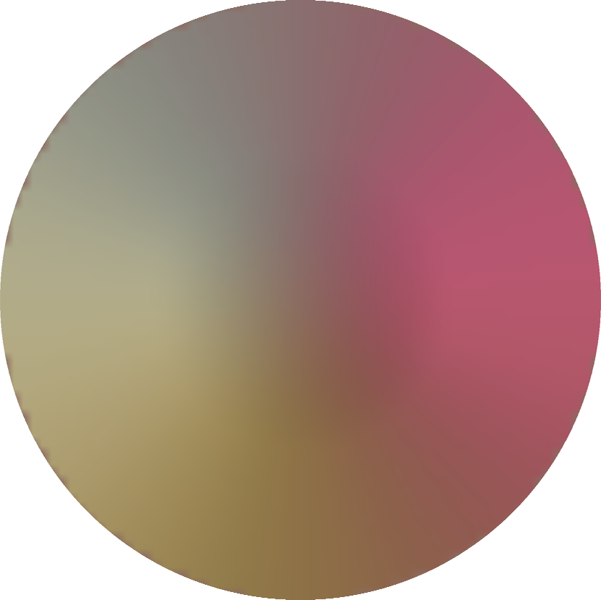
Our Environment Map
Environment filtering
Border pixel extrapolated envmap
Diffuse filtered envmap

Slide 13
Our Environment Map
Average Extrapolation
  Border pixel
    Spans a very large solid angle in the environment map
    Possibly inaccurate and unstable estimation
  Our solution: Average intensity
    First: while filtering
      Keeping track of the unknown lighting values
    Second: average extrapolation
      Average lighting
        center pixel of the diffuse environment map

Slide 14

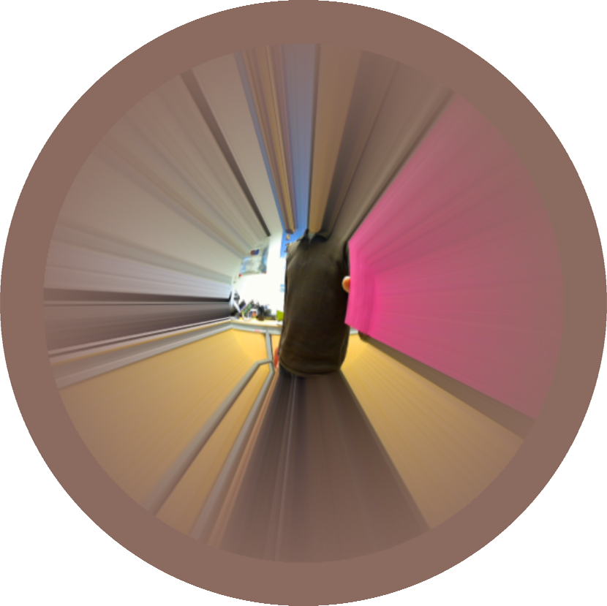
Our Environment Map
Average Extrapolation
Average extrapolation
Diffuse filtered envmap

Slide 15
Outline
  Classical environment map
  Our solution
    Angular mapping
    Filtering
    Extrapolation
  Results

Slide 16
Results
Performances
  Logitech QuickCam Pro 9000
  Laptop
    Intel Core 2 Duo 2.4GHz CPU
    QuadroFX 1600M GPU
  Texture resolutions
    Webcam capture: 800x600
    Angular map: 600x600
    Diffuse/glossy filtered environment map : 64x64

Slide 17
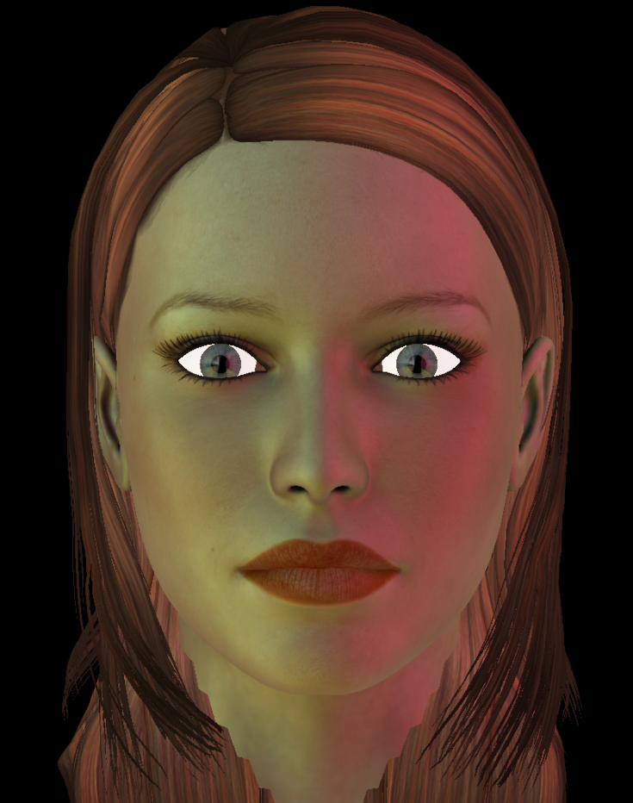

Results
Human head (40K polygons)
  3 environment maps
    Mirror
    Diffuse
    Glossy
    HDRShop filtering
      ~20 seconds per texture 64x64
VIDEO
25 FPS

Slide 18
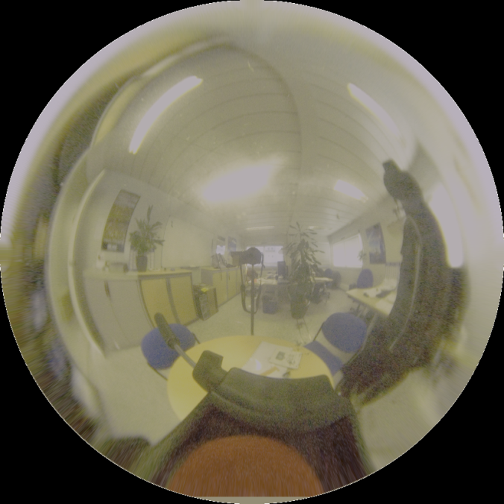
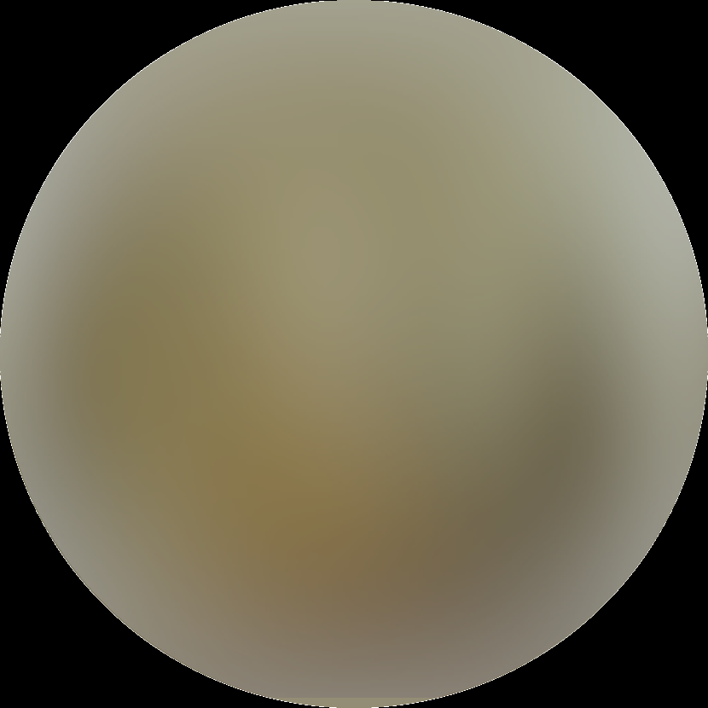
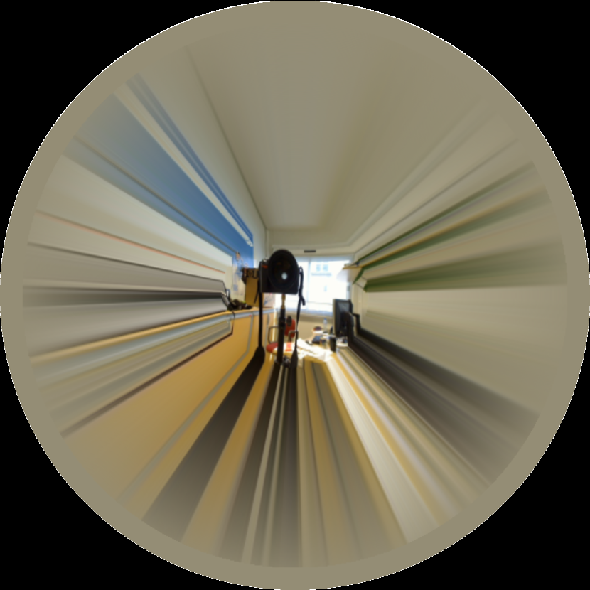
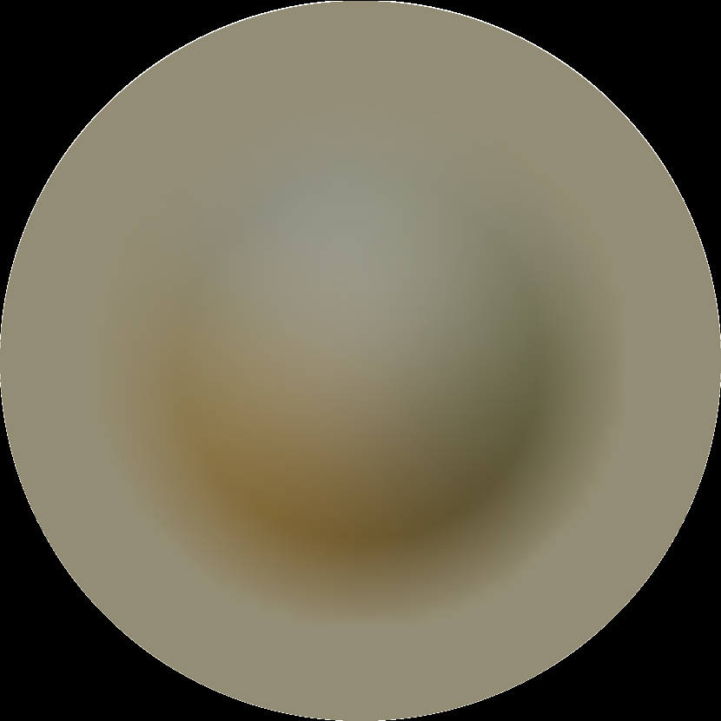
Results - Comparison
a. Picture of a mirror ball [Debevec 97]
b. Webcam approximation

Slide 19
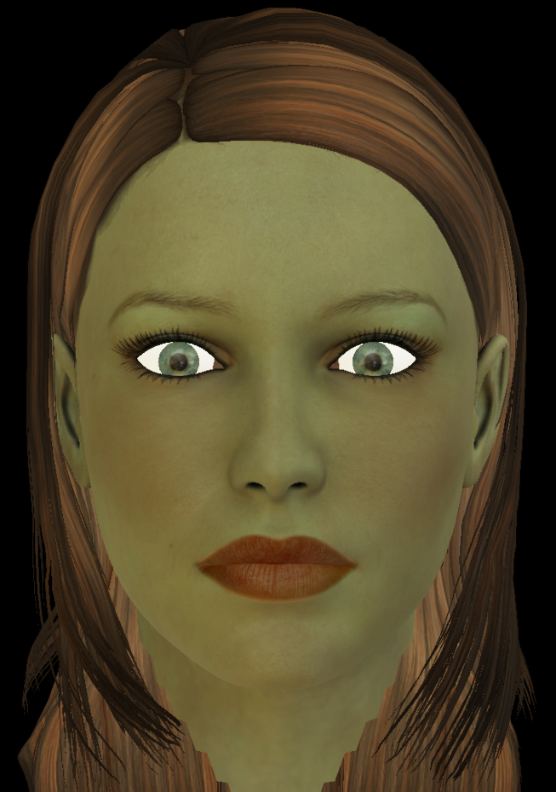
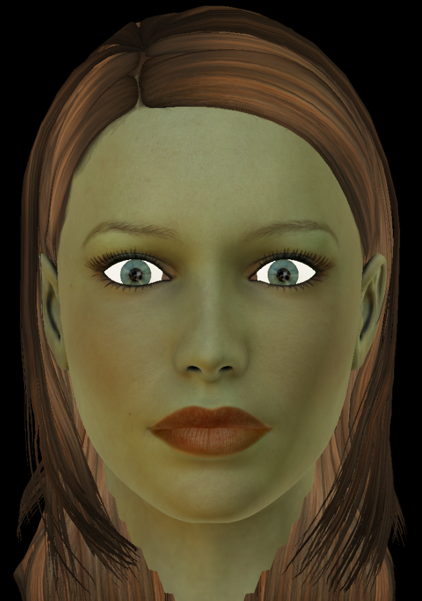
Results - Comparison
25 FPS
Webcam approximation
a. Picture of a mirror ball
b. Webcam approximation

Slide 20
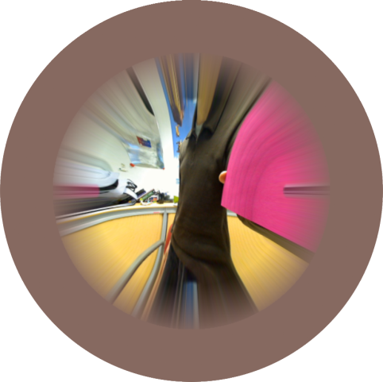
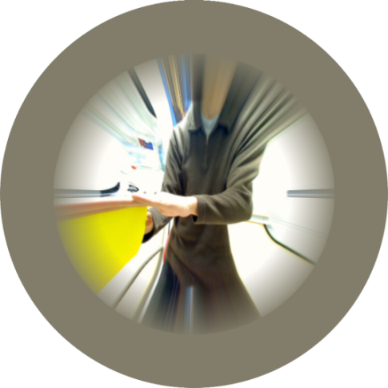
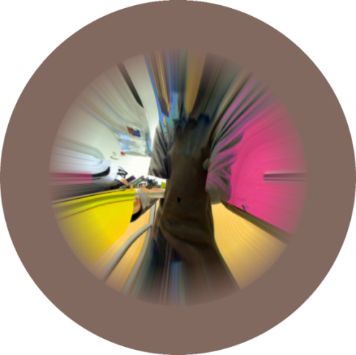
Applications
25 FPS
  Virtual worlds
    Lighting the avatar using the user webcam
    Enhances immersion
  Lighting edition tool
    Using real light for building virtual environment map
    Combination of several environment maps
Capture 1
Capture 2
Capture 1+2

Slide 21
Discussion
25 FPS
  Artificially widening the aperture
    Webcam aperture usually small
    Border pixel extrapolation introduces artifacts
    Artificially widen the aperture reduces this problem
    Physically incorrect
    Emphasizes the movement of real objects

Slide 22
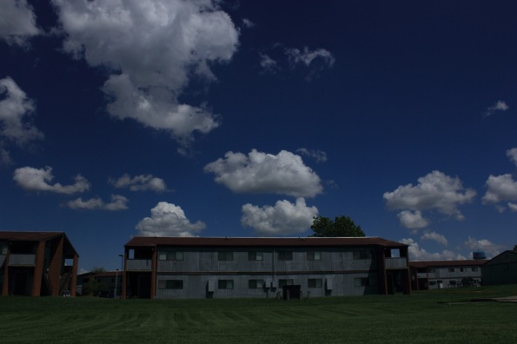
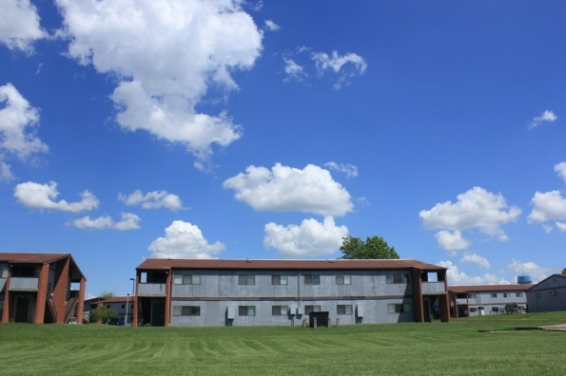
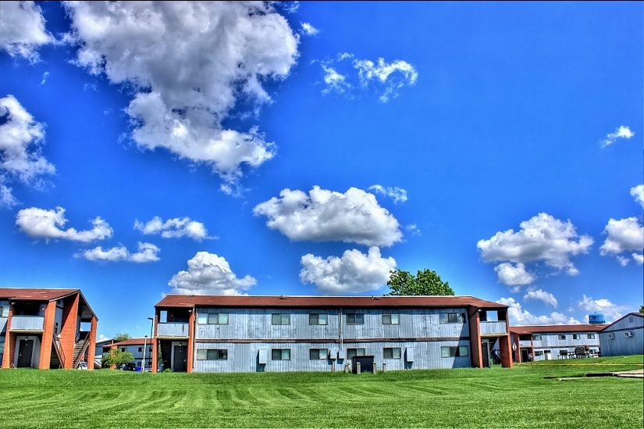
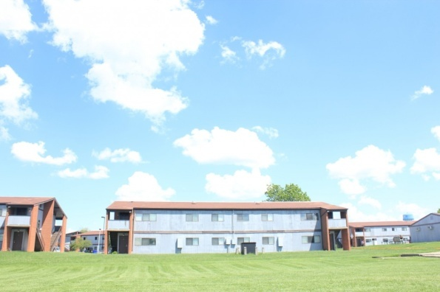
Future work
25 FPS
  High Dynamic Range
    Offline methods generate HDR environment maps
    Not possible with simple webcams
    [Kang et al. 03], [Bennett and McMillan 05]
      Temporal bracketing
        Increase dynamic range
        Modyfing the exposure of the webcam sensor

Slide 23
Conclusion
  Lighting information extraction using a classic webcam
  Approximated but plausible environment maps
  Simple
  Inexpensive
  Real Time
  Immersion

Slide 24
Thanks
Questions?

